Slide 1
Level 4/5 – Group 6
Tom Gibbs
Fraser King
Jack Massey
Daniel Marsh

Slide 2
The Brief
2D
Tap input
Turn-based single-device multiplayer
Symmetric level design
Easy to learn game yet hard to master
Notes:
Input is single instant of contact.
Local multiplayer – adversarial. Asynchronous player turns.
Symmetric – players have access to the same knowledge and equal opportunity regarding input effect.

Slide 3
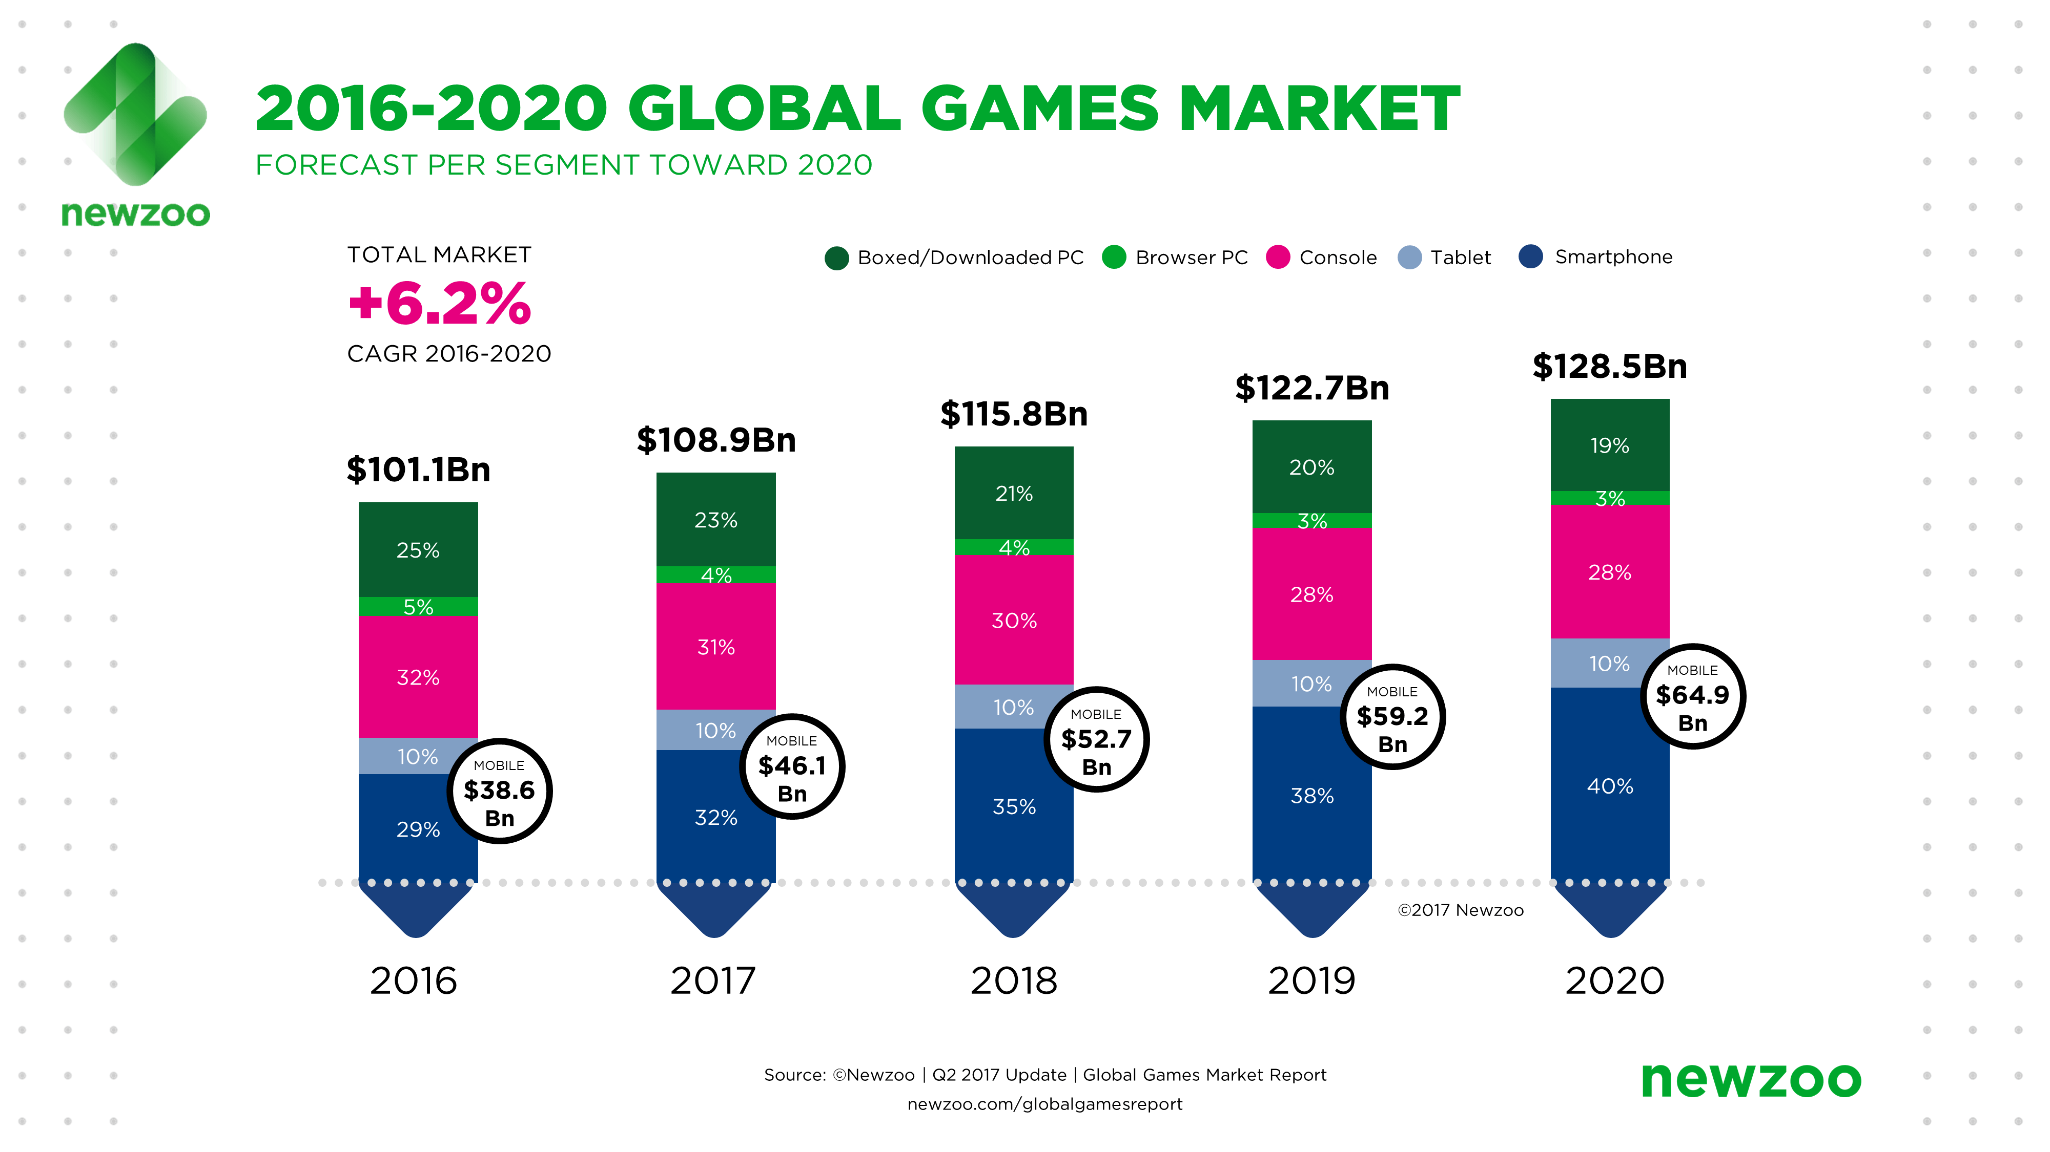
Market Research
Why Mobile?
Newzoo.com [2017]

Slide 4
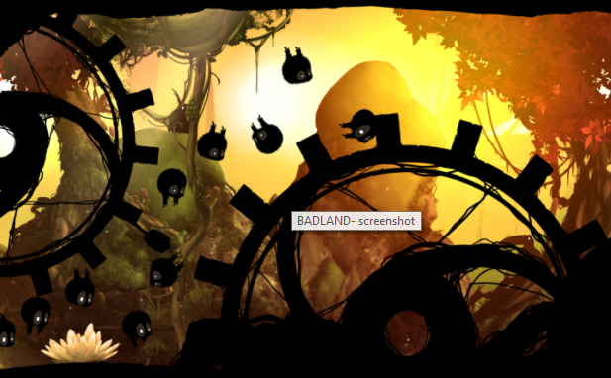
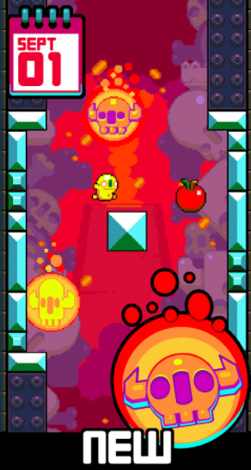
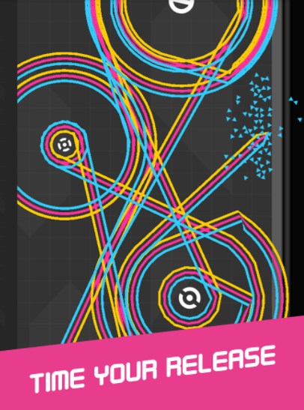
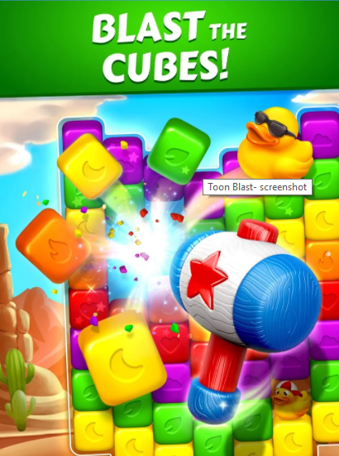
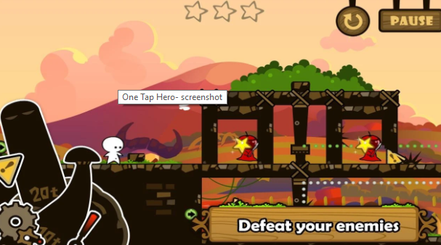
Existing Games
BADLAND
Toon Blast
One More Line
Leap Day
One Tap Hero
Notes:
Existing mechanics
visuals

Slide 5
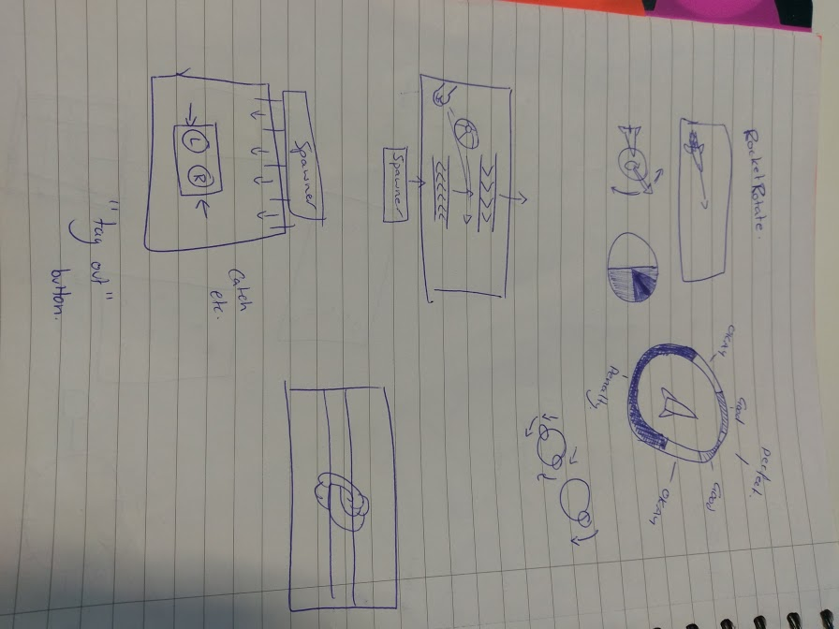
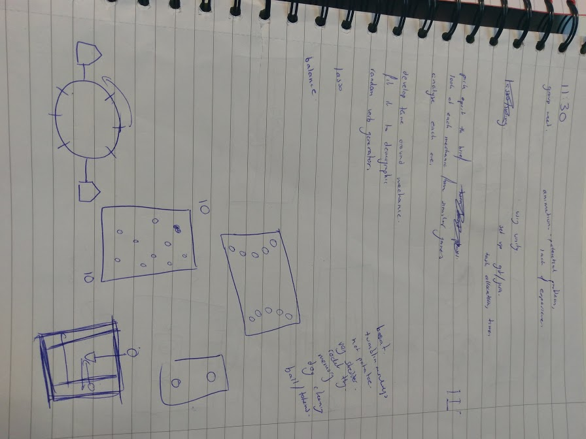
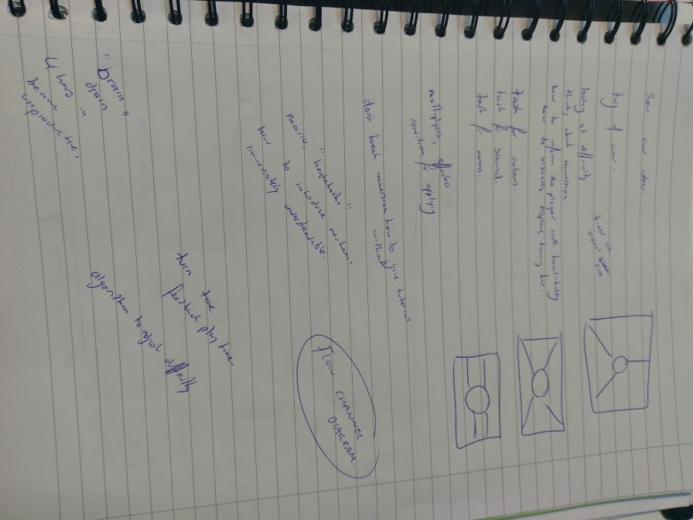
Developing Mechanics

Slide 6
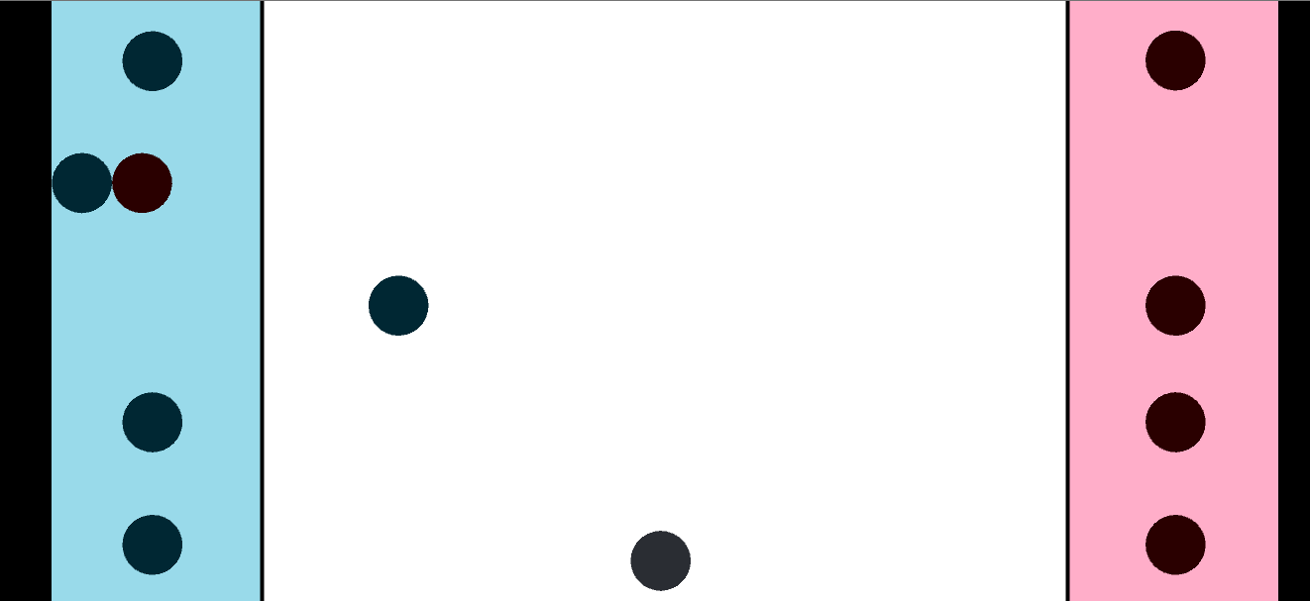
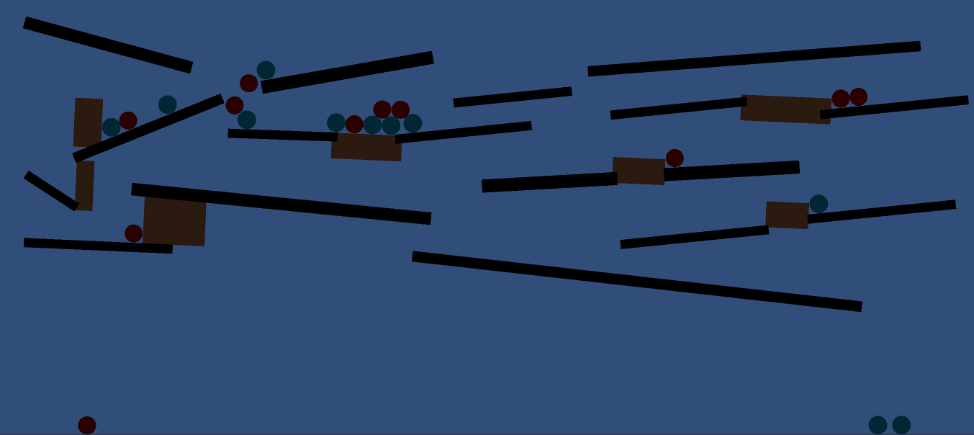

Developing Mechanics

Slide 7
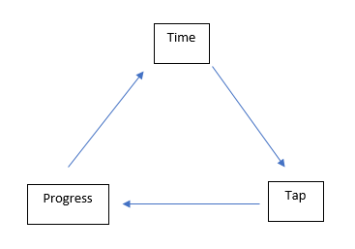
Game Concept
Tug-of-war styled game, not tug-of-war themed game
What the player does
Telegraphing and feedback
Mechanics
Learning curve –Learn, Practice, Master
Notes:
Overscoping, limiting design to refined features
Difficulty scaling
How to communicate timing/intention to player effectively

Slide 8
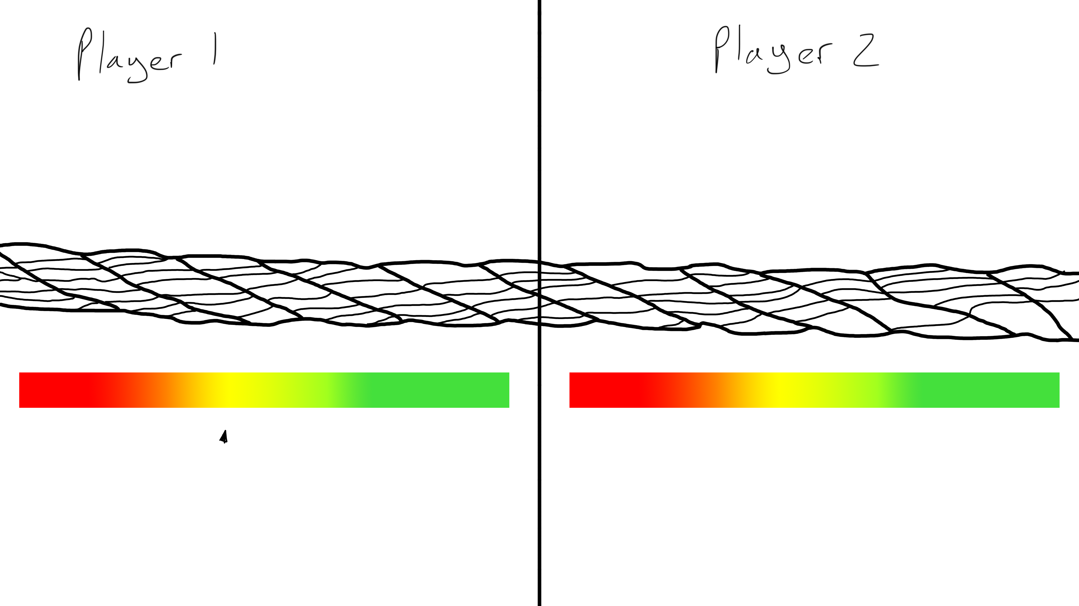
Game Concept
Easy to play.
Simple yet has complex gameplay.
Notes:
Telegraphing to the player things

Slide 9
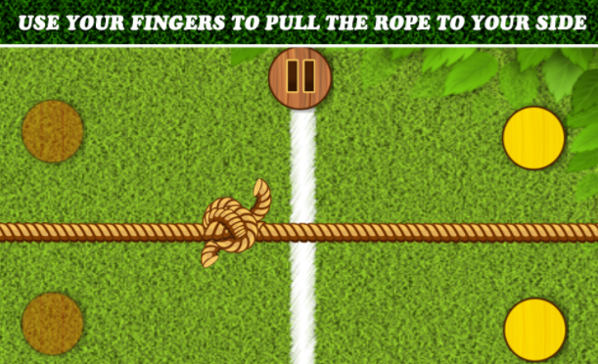
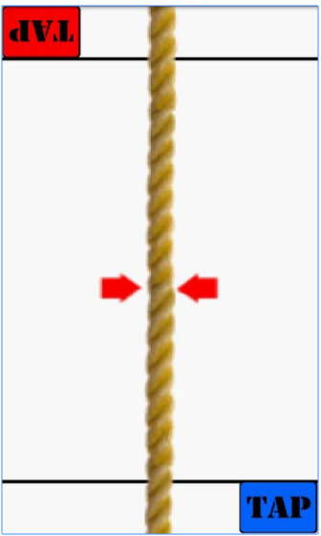
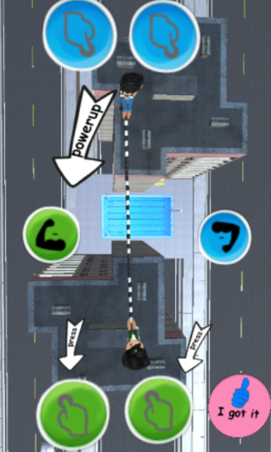
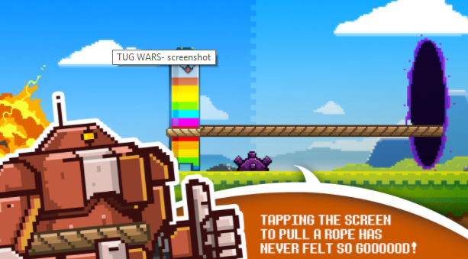
Similar Games
Tug of War Utmost Strength Battle Competition
Tug of War
Tug of War 3D
TUG WARS

Slide 10
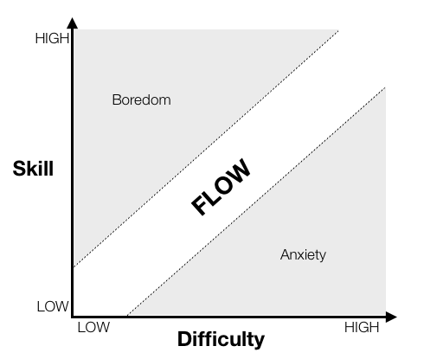
Flow State and Cognitive Immersion
Engagement and immersion
Players facilities, hand-eye, timing
Player’s mental state when fully engaged, the player becomes Hyper aware of the game
Difficulty determining algorithm

Slide 11
4 Keys to Fun
Hard
Easy
Serious
People

Slide 12
Theme Development
Tug-of-war styled game, not tug-of-war themed game
Explored random generators
Demographics, psychographics

Slide 13
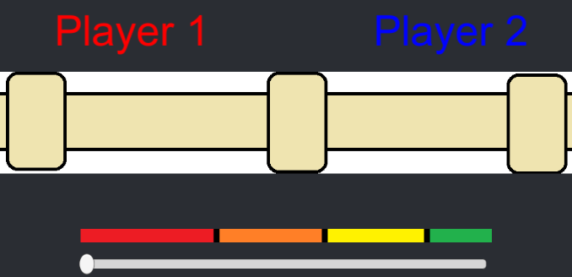

Prototype
Stretch goals

Slide 14
Moving forward…
Design challenges
Telegraphing when the player should tap
Has to be self-explanatory and natural
Sizing of timing windows

Slide 15
Questions?

